Slide 1
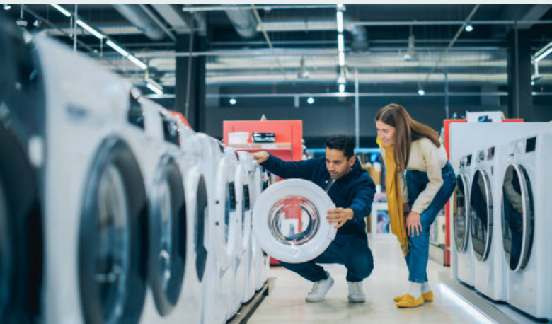
SERENITY RETAIL BUSINESS ANALYSIS
JUMMAI BATNAH COHORT 24-05 OCT 2024

Slide 2
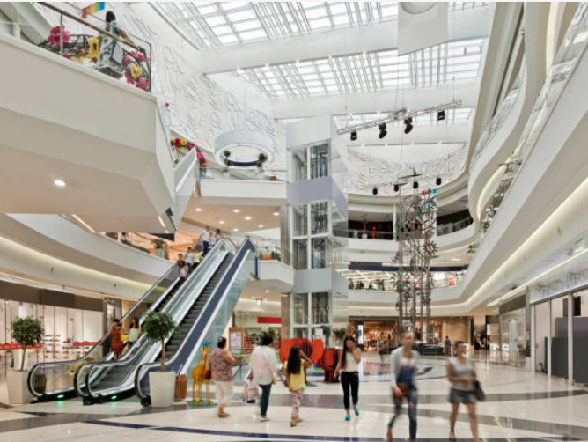
TABLE OF CONTENTS
INTRODUCTION
OBJECTIVES
BACKGROUND
DATA COLLECTION AND PROCESSING
DASHBOARDs
INSIGHTS
RECOMMENDATIONS
DATA LIMITATIONS
CONCLUSIONS

Slide 3
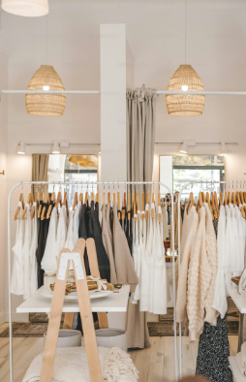
INTRODUCTION
Serenity Retail is a nationwide chain that offers a wide range of products, including electronics, clothing, and groceries.
To better engage its diverse customers, the company aims to segment them based on demographics ,purchasing behavior and psychographics .
This project focuses on creating a market segmentation strategy to improve targeted marketing, increase customer satisfaction, and boost profitability.

Slide 4
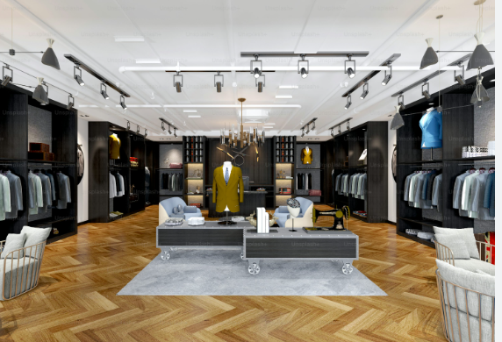
OBJECTIVES
Consolidate and integrate customer data from various sources into a centralized Power BI data model.
2. Analyze customer segments and provide actionable insights and recommendations.
3. Use Power BI to create visuals highlighting spending behavior across different demographics and purchasing preferences.
4. Improve marketing strategies by leveraging data analysis to align with customer preferences and optimize profitability.

Slide 5
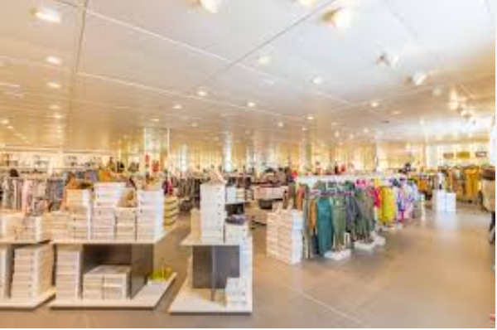
BACKGROUND
Serenity Retail is a major retail chain offering a wide range of products like electronics, clothing, home goods, and groceries.
The company aims to better understand its diverse customer base for more targeted marketing efforts. Currently, there is no structured approach for segmenting customers based on their preferences.

Slide 6
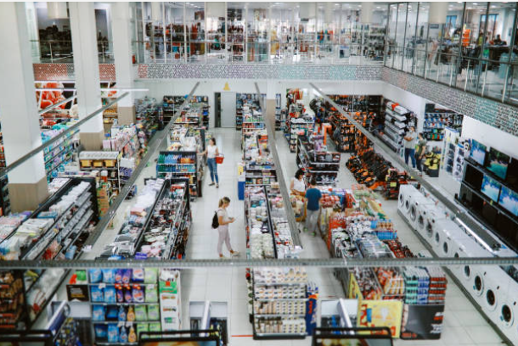
DATA COLLECTION AND PROCESSING
The process started by gathering customer data from different departments and importing it into Power BI for initial data cleaning.
After the data was cleansed, it was transformed and integrated within Power BI’s data model, ensuring all necessary relationships between tables were established.
Tables, Calculated columns, and measures were then created to enhance the analysis.
Finally, interactive dashboards were built within Power BI to visualize customer segmentation and insights effectively.

Slide 7
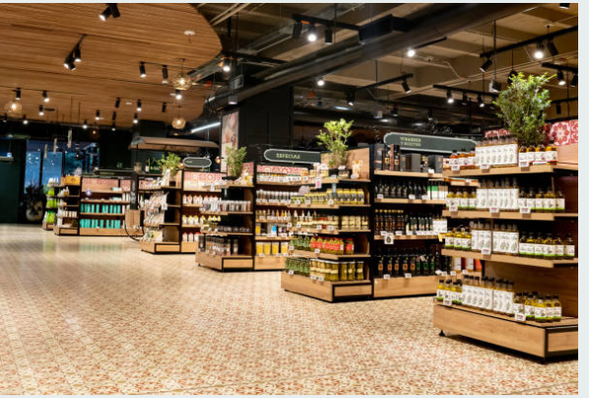
DASHBOARDS

Slide 8
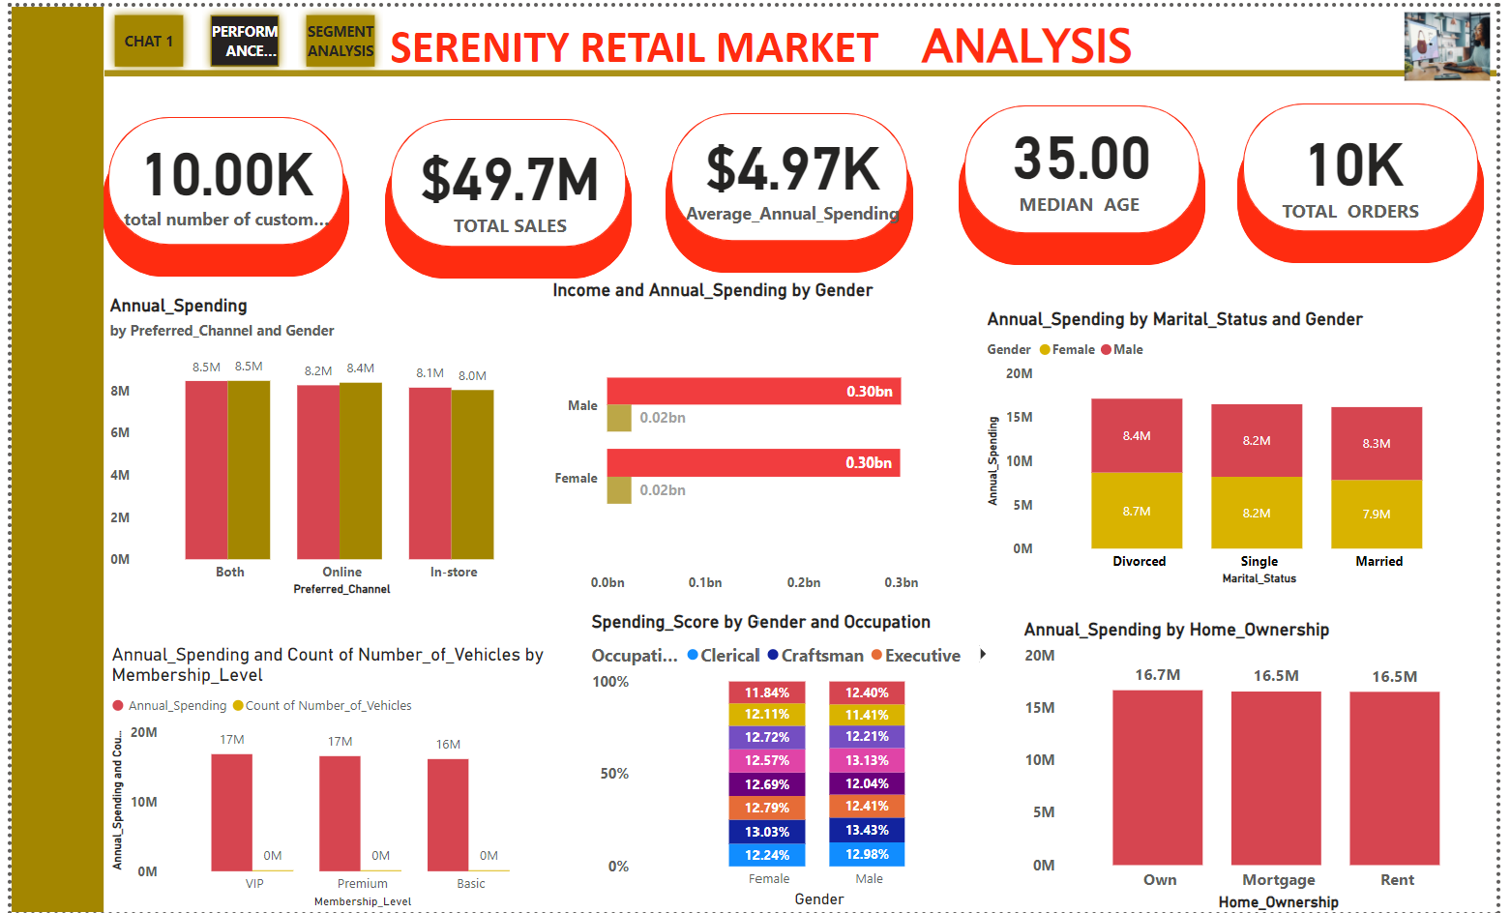

Slide 9
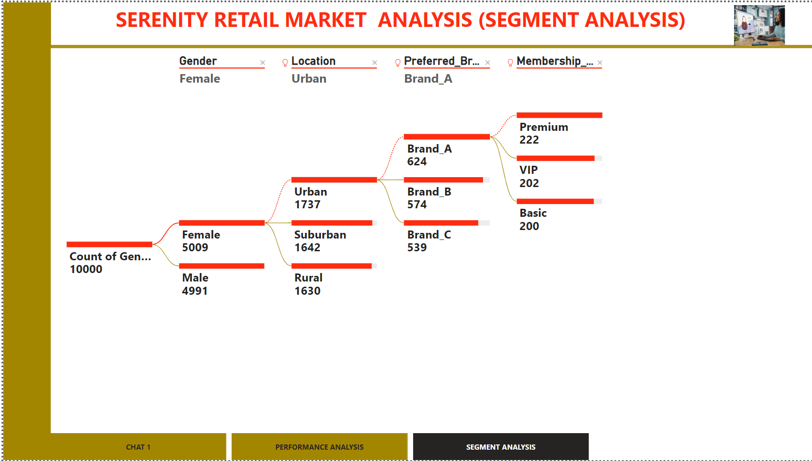

Slide 10

INSIGHTS

Slide 11
KPIs
TOTAL NUMBER OF CUSTOMERS
AVERAGE ANNUAL SPENDING
10,000
$5000
TOTAL SALES
$49.7M
MEDIAN AGE
TOTAL NUMBER OF ORDERS
35YRS
10,000

Slide 12
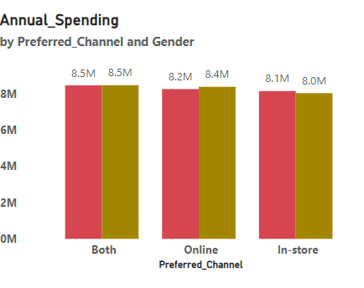
INSIGHTS
Online Channel
Males (8,372M) spend more online, focusing on electronics and high-ticket items, while females (8,249M) shop more frequently for household and clothing items but spend less overall.
In-store Channel:
Females (8,137M) spend the most on groceries, household essentials, and apparel in-store, while males(8,022M) spend the most on tools and hardware.
Both Channels:
Customers using both channels, often VIP members, spend the most overall. Males(8,461M) slightly outspend females(8,454M), especially on premium online purchases.

Slide 13
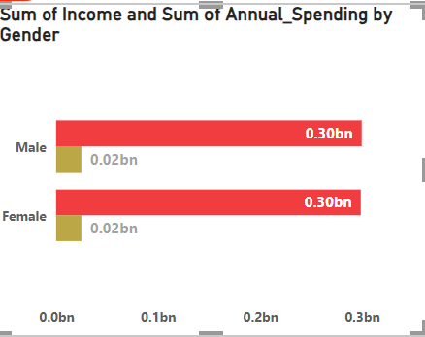
INSIGHTS
High Income (Above $100,000): Males spend more on luxury items and electronics, while females focus on clothing and home goods, often making frequent lower-value purchases.
Middle Income ($50,000 - $100,000): Males prioritize electronics and home improvement, whereas females buy household and personal items, shopping more frequently for mid-range goods.
Low Income (Below $50,000): Females frequently spend on essentials like groceries, while males focus on fewer, high-utility items such as tools.

Slide 14
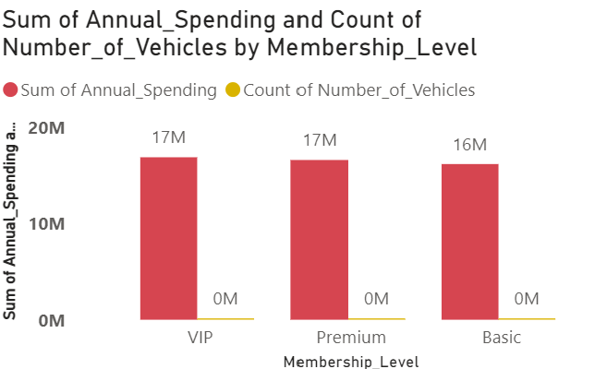
INSIGHTS
VIP Members have the highest total annual spending, amounting to approximately $16.9 million. On average, they own min of 1-2 vehicles.
Premium Members follow closely, with a total annual spending of about $16.6 million. Their average vehicle ownership is about 1 vehicle per person.
Basic Members have the lowest total annual spending at approximately $16.2 million, and they also own slightly fewer vehicles on average (around 0.97 vehicles).

Slide 15
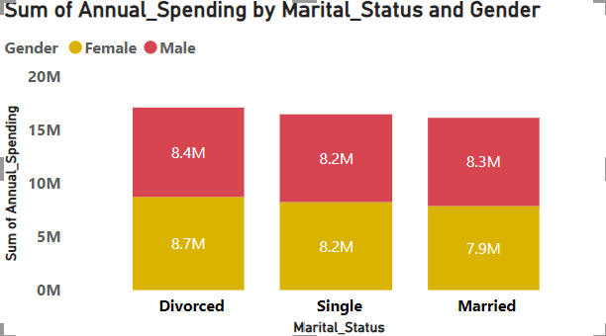
INSIGHTS
Female Customers:
Divorced females have the highest total annual spending, amounting to $8.73 million.
Single females follow closely with a total spending of $8.24 million.
Married females have slightly lower total spending, totaling $7.87 million.
Male Customers:
Divorced males lead in total spending with $8.37 million.
Married males also show significant spending, totaling $8.26 million.
Single males have the lowest spending among males, with a total of $8.22 million.

Slide 16
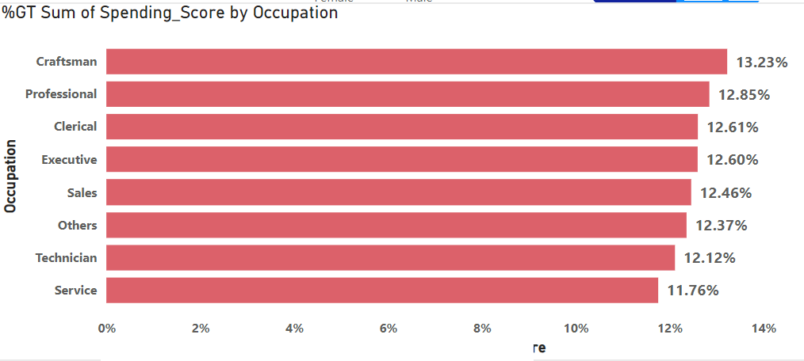
INSIGHTS
Professionals and craftsmen (High Spending Score):
Males: High-value purchases in electronics, luxury goods, and premium brands.
Females: Frequent, smaller purchases in household goods, clothing, and personal care.
Service Workers (Moderate Spending Score):
Males: Spend on tools and automotive products.
Females: Focus on clothing and family-related purchases.
Students and Entry-level Occupations (Low Spending Score):
Both genders spend on affordable essentials like groceries, basic apparel, and low-cost personal care items.

Slide 17
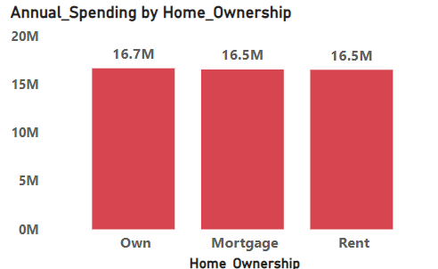
INSIGHTS
Homeowners (Own):
Highest annual spending.
Invest in home improvement, furniture, and high-end appliances.
Mortgage Holders:
High spending, slightly lower than homeowners.
Focus on mid-range home improvement, furniture, and family essentials.
Renters:
Lowest annual spending.
Spend on everyday necessities, affordable household items, and basic furniture.

Slide 18
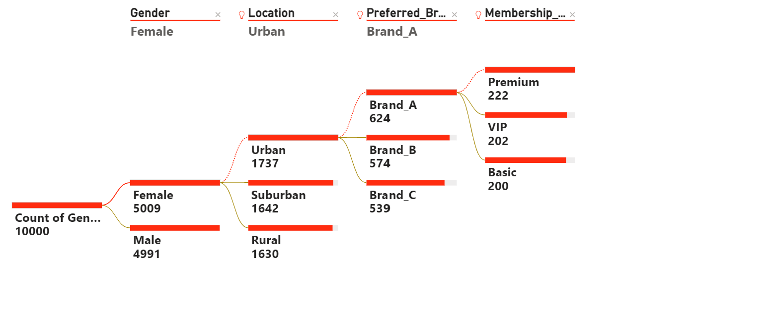
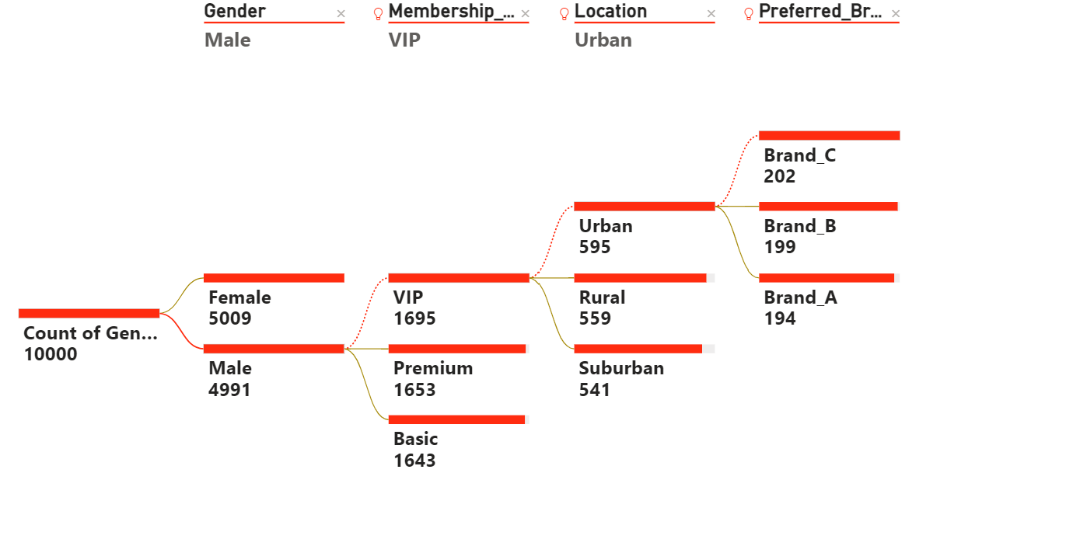
INSIGHTS
Gender: Males(49.99%) prefer high-ticket, premium brands, while females(50.01%) engage in frequent, smaller purchases, mostly from household brands.
Membership Level: VIP members are the most valuable, with loyalty to premium brands. Upselling basic members through personalized offers can increase their spending.
Location: Urban customers prefer online shopping and high-end brands, while suburban and rural customers lean toward in-store purchases of essential goods.
Preferred Brand: Customers' brand preferences are linked with their membership and spending level, with high-end brands preferred by VIP members and affordable brands by basic members.
SUMMARY TABLE(HIGH VALUES)
S/NO | SEGMENT | MALE | FEMALE
1 | COUNT OF GENDER | 4991 | 5009
2 | LOCATION | URBAN(1737) | URBAN(595)
3 | PREFERRED BRAND | BRAND C(202) | BRAND A(624)
4 | MEMBERSHIP | VIP(1695) | PREMIUM(222)

Slide 19
Recommendations
Target VIP members with multiple cars by offering premium automotive accessories and exclusive deals on high-end electronics, as they exhibit the highest annual spending.
Launch cross-channel promotions for customers who shop both online and in-store, with personalized offers for convenience-driven shopping, particularly for high-income males.
Offer premium family-oriented products (such as home improvement items and electronics) to married males, who have the highest annual spending in this group.
Develop loyalty programs for married females, focusing on household essentials and grocery items, to encourage higher spending through frequent purchases.
Create value-based promotions for service workers and teachers, targeting essential items like groceries, clothing, and household goods, given their moderate spending behavior.

Slide 20
Recommendations
Offer exclusive deals on luxury products for professionals and executives, such as high-end electronics and home furnishings, to cater to their high annual spending patterns.
Promote budget-friendly product bundles for students and entry-level workers, who focus on affordable essentials and show lower overall spending.
Target renters with affordable furniture and home goods offer, aligning with their lower spending capacity but frequent purchases of basic household items.
Introduce family-focused membership rewards for mortgage holders, emphasizing mid-range home improvement products and essential household items to drive engagement.
Develop targeted marketing for homeowners with promotions on long-term home investments, such as appliances and premium home improvement products, given their highest annual spending.

Slide 21
DATA LIMITATIONS
Data Quality: Missing or inconsistent values in income and spending scores could affect accuracy.
Bias: The insights may be skewed if the dataset doesn’t represent all customer types (e.g., more urban than rural).
Limited Timeframe: A short data collection period may not capture seasonal trends, limiting the analysis for long-term strategies.
Static Data: Without real-time updates, the dataset only reflects a snapshot of customer behavior, which may quickly become outdated.

Slide 22
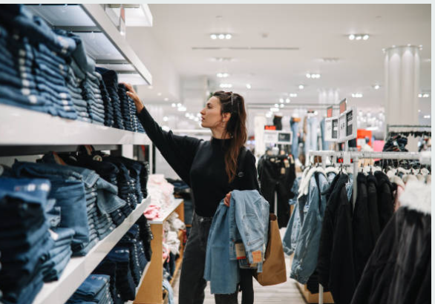
CONCLUSIONS
Homeowners and VIP members are the highest spenders, particularly on home improvement, automotive, and premium products, presenting key opportunities for high-end promotions.
Marital status significantly impacts spending, with married males and females leading in different categories, indicating a need for gender-specific, family-oriented marketing strategies.
Occupation influences spending behavior, with professionals and executives prioritizing luxury goods, while service workers and students focus on essentials.
Income levels strongly correlate with annual spending, with high-income customers spending more on premium products, especially through online channels.
Car ownership and membership levels affect spending habits, highlighting opportunities for cross-channel and loyalty-based promotions targeting specific customer segments.

Slide 23
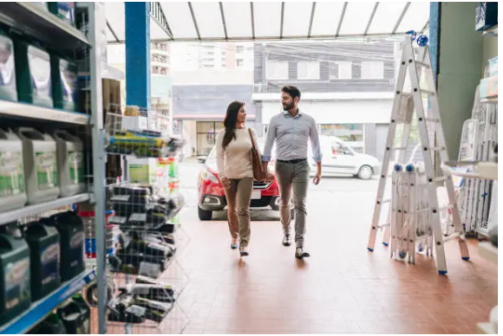
THANK YOU

